Slide 1
Lecture 3
Solution of Nonlinear Equations
( Root Finding Problems )
  Definitions
  Classification of Methods
    Analytical Solutions
    Graphical Methods
    Numerical Methods
      Bracketing Methods
      Open Methods
  Convergence Notations
Notes:
02/01/23

Slide 2

Mathematical Equations
Algebric Equations
Polynomial Equations
Transcendental Equations
Differential Equations
Integral Equations
Linear
Ordinary
Nonlinear
Partial
Continuous
Trigonometric
Definite
Logarithmic
Piecewise
Exponential
Indefinite

Slide 3

Numerical computing is an approach for solving complex mathematical problems using only simple arithmatic operations
The appoarch involves, in most of the cases, formulation of mathematical models of physical situations that can be solved with arithmatic operations
It requires development, analysis and use of algorithm
Algorithm is a systematic procedure that solves a problem or a number of problems
Its efficiency may be measured by the number of steps in the algoritm, the computer time, and the amount of memory (of the computing instrument) that is required

Slide 4

The major advantage of numerical methods is that a numerical value can be obtained even when the problem has no “analytical” solution
The mathematical operations required are essentially addition, subtraction, multiplication, and division plus making comparisons
It is important to realize that solution by numerical analysis is always numerical
Analytical methods, on the other hand, usually give a result in terms of mathematical functions that can then be evaluated for specific instances

Slide 5

Finding roots of equations
Solving systems of linear algebric equations
Interpolation and regression analysis
Numerical differentiation
Numerical Integration
Solution of ordinary differential equations
Boundary value problems
Solution of matrix problem

Slide 6

Step #1:
State the problem clearly, including any simplifying assumptions.
Step #2:
Develop a mathematical statement of the problem in a form that can be solved for a numerical answer
This process may involve the use of calculus.
In some situations, other mathematical procedures may be employed.
When this statement is a differential equation, appropiate initial conditions and/or boundary conditions must be specified

Slide 7
Step #3:
Solve the equations that are obtained from step #2
Sometimes the method will be algebric
But frequently more advanced methods will be needed
The result of this step is a numerical answer or set of answers
Step #4:
Interpret the numerical result to arrive at a decision
This will require experience and understanding of the situation in which the problem is embedded

Slide 8

Mathematical Concepts
Computer & Software
Physical Problem
Mathematical Model
Numerical Method
Implementation
Modify Model
Change Method
Improve algorithm
Solution
Wrong
Validity
Application
Correct

Slide 9

Numerical analysis is an approximation, but results can be made as accurately as desired.
Errors come in a variety forms and sizes; some are avoidable and some are not
For example, data conversion and roundoff errors can not be avoided, but human errors can be eliminated
Although certain errors can not be eliminated completely, we must atleast know the bounds of these errors to make use of our final selection
It is therefore essential to know that how errors arise, how they grow during numerical process and how they affect the accuracy of a solution

Slide 10

Total
error
Modelling errors
Inherent errors
Numerical errors
Blunders
Missing Information
Human Imperfection
Data error
Conversion error
Roundoff error
Trancation error
Measuring method
Computing machine
Numerical method

Slide 11

In many situations it is impractical to model each of the components accurately and so certain simplifying assumptions are made
For example, while developing a model for calculaing the force acting on a falling body, we may not be able to estimate the air resistance coefficient (drag coefficient) properly or determine the direction and magnitude of wind force acting on the body and so on
Since the model is the basic input to the numerical process, no numerical method will provide adequate results if the model is erroneously conceived and formulated

Slide 12

Inherent error (also known as input error) contain two components, namely, data errors and conversion errors
Data error
Data error (also known as emperical error) arises when data for a problem are obtained by some experimental means and are, therefore, of limited accuracy and precision
Conversion error
Conversion error (also known as representational error) arise due to the limitations of the computer to store the data exactly

Slide 13

Numerical errors (also known as procedural error) are introduced during the process of implementation of a numerical method
Roundoff error
Roundoff error occur when a fixed number of digits are used to represent exact numbers
42.7893 will be rounded off upto 2 decimal digits as 42.79
Trancation error
Trancation error arise from using an approximation in place of an exact mathematical procedure
Typically it is the error resulting from the trancation of numerical process
We often use finite number of terms to estimate the sum of infinite series

Slide 14

Blunders are the errors that are caused due to human imperfection
Some common type of this error are:
  Lack of understanding of the problem
  Wrong assumption
  Overlooking of some basic assumptions required for formulating the model
  Error in deriving the mathematical equation or using a model that does not describe adequately the physical system under study
  Selecting a wrong numerical method for solving the mathematical model
  Selecting a wrong algorithm for implementing the numerical method
  Making mistakes in the computer program
  Mistake in data input
  Wrong guessing the initial value

Slide 15
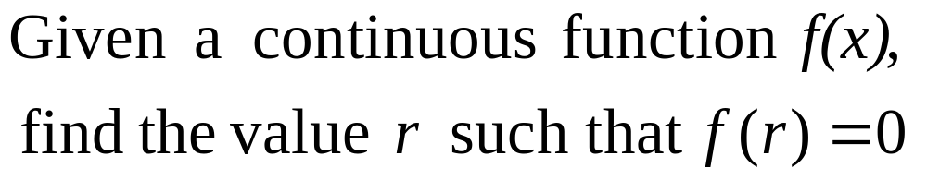
Root Finding Problems
Many problems in Science and Engineering are expressed as:
These problems are called root finding problems.
Notes:
02/01/23

Slide 16
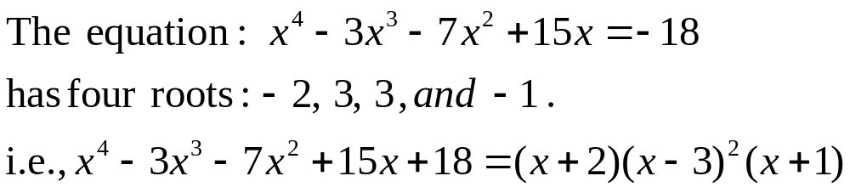
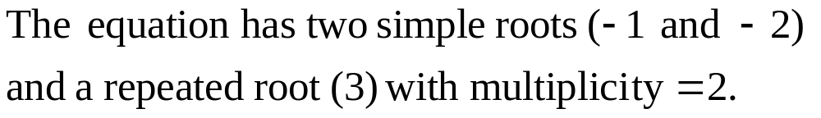
Roots of Equations
A number r that satisfies an equation is called a root of the equation.
Notes:
02/01/23

Slide 17
Zeros of a Function
Let f(x) be a real-valued function of a real variable. Any number r for which f(r)=0 is called a zero of the function.
Examples:
2 and 3 are zeros of the function f(x) = (x-2)(x-3).
Notes:
02/01/23

Slide 18
Graphical Interpretation of Zeros
The real zeros of a function f(x) are the values of x at which the graph of the function crosses (or touches) the x-axis.
f(x)
Real zeros of f(x)
Notes:
02/01/23

Slide 19

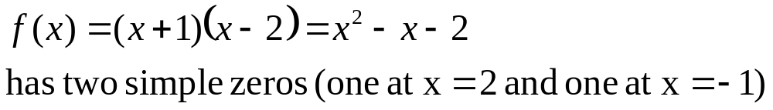
Simple Zeros
Notes:
02/01/23

Slide 20

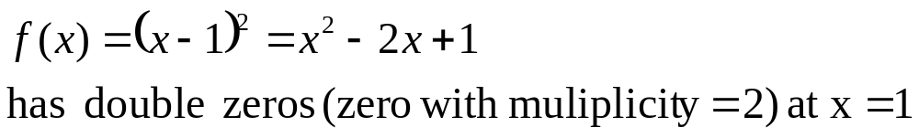
Multiple Zeros
Notes:
02/01/23

Slide 21

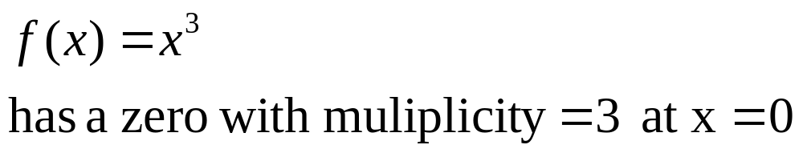
Multiple Zeros
Notes:
02/01/23

Slide 22
Facts
Any n^{th} order polynomial has exactly n zeros (counting real and complex zeros with their multiplicities).
Any polynomial with an odd order has at least one real zero.
If a function has a zero at x=r with multiplicity m then the function and its first (m-1) derivatives are zero at x=r and the m^{th} derivative at r is not zero.
Notes:
02/01/23

Slide 23
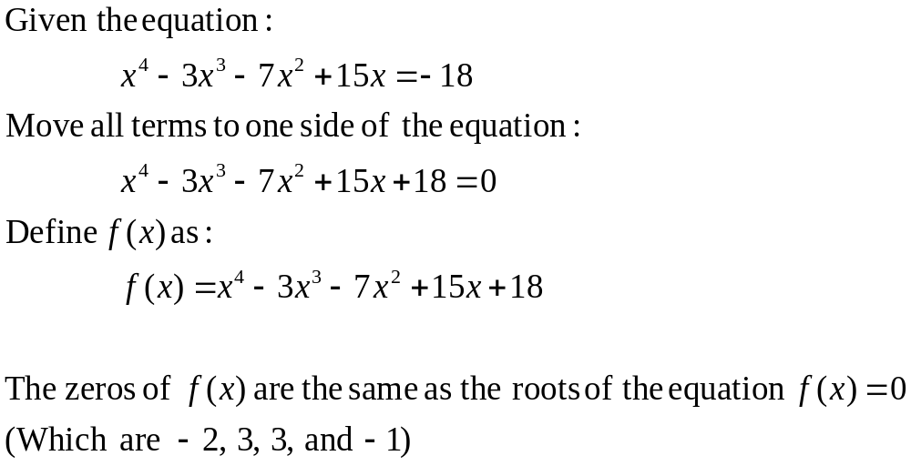
Roots of Equations & Zeros of Function
Notes:
02/01/23

Slide 24
Solution Methods
Several ways to solve nonlinear equations are possible:
  Analytical Solutions
    Possible for special equations only
  Graphical Solutions
    Useful for providing initial guesses for other methods
  Numerical Solutions
    Open methods
    Bracketing methods
Notes:
02/01/23

Slide 25
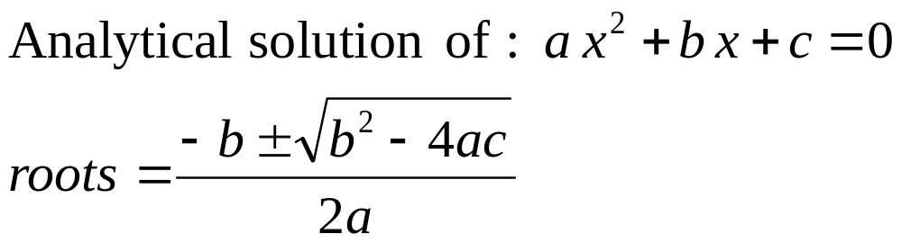
Analytical Methods
Analytical Solutions are available for special equations only.
Notes:
02/01/23

Slide 26
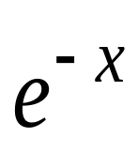
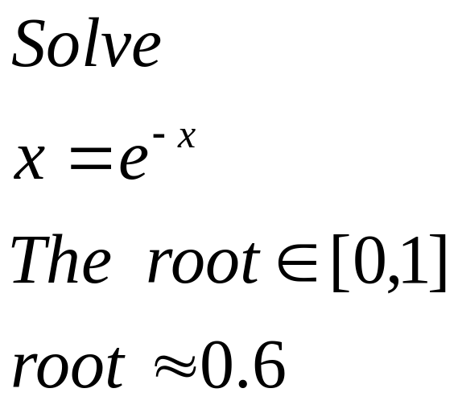

Graphical Methods
Graphical methods are useful to provide an initial guess to be used by other methods.
Root
2
1
1 2
Notes:
02/01/23

Slide 27
Numerical Iterative Methods
An iterative technique usually begins with an approximate value of the root, known as the initial guess, which is then successively corrected iteration by iteration under a certain mathematical basis
The process of iteration stops when the desired level of accuracy is obtained
Since ,in many cases, the iterative method needs a large number of iterations and arithmatic opeartion to reach a solution, the use of computers has become inevitable to make the task simple and efficient

Slide 28

Iterative methods, based on the number of guesses they use, can be categorized into two categories:
  Bracketing methods (Interpolation methods)
  Open end methods (Extrapolation methods)
Bracketing methods starts with two initial guesses that ‘bracket’ the root and then systematically reduce the width of the bracket until the solution is reached
Two popular methods under Bracketing category are
  Bisection method
  False position method
These methods are based on the assumption that the function changes sign in the vicinity of a root

Slide 29
Open end methods use a single starting value or two values that do not necessarily bracket the root
The following iterative methods fall under this category:
  Newton-Raphson method
  Secant method
  Muller’s method
  Fixed-point method
  Bairstow’s method

Slide 30

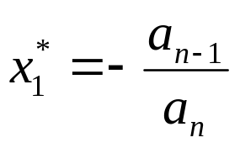
Before an iterative process is initaited, we have to determine either an approximate value of root or a ‘search’ interval that contains a root
One simple method is to plot the function
Graphical representation will not only provide us rough estimate of the root but also help us in understanding the properties of the function
Largest possible root
For a polynomial represented by
the largest possible root is given by

Slide 31
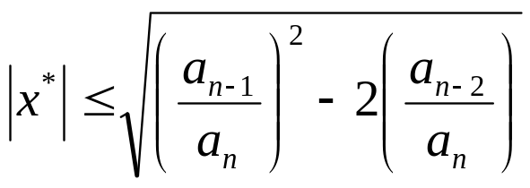
Search Bracket
Another relationship that might be useful for determining the search intervals that contain the real roots of a polynomial is
where x is the root of the polynomial. This will be the maximum absolute value of the roots
That means that no roots exceed x_{max} in absolute magnitude and thus, all real roots lie within the interval
(-|x*_{max} |,|x*_{max}|)

Slide 32

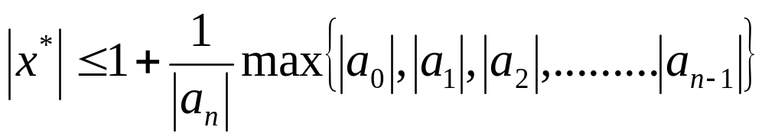
There is another relationship that suggests an interval for roots.
All roots x satisfy the inequality
where the ‘max’ denotes the maximum of the absolute values of |a₀|, |a₁|, |a₂|,...... |a_{n-2}|, |a_{n-1}|

Slide 33


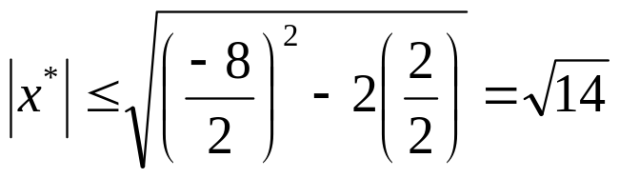

Consider the polynomial equation
Estimate the possible initial guess value
------------------------------------------
The largest possible root is
That is, no root can be larger than the value 4
All roots must satisfy the relation
Therefore, all real roots lie in the interval .
We can use these two points as initial guesses for the bracketing methods and one of them for the open end methods

Slide 34


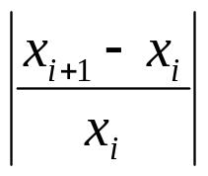
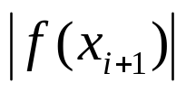
We must have an objective criterion for deciding when to stop the process
We may use one of the following tests
  < E_{a} (absolute error in x)
  < E_{r} (relative error in x) x<>0
  < E (value of function at root)
There may be the situations where these tests may fail
In cases where we do not know whether the process converges or not, we must have a limit on the number of iterations, like
Iterations > N (limit on iterations)

Slide 35
Bracketing Methods
In bracketing methods, the method starts with an interval that contains the root and a procedure is used to obtain a smaller interval containing the root.
Examples of bracketing methods:
  Bisection method
  False position method
Notes:
02/01/23

Slide 36
Open Methods
In the open methods, the method starts with one or more initial guess points. In each iteration, a new guess of the root is obtained.
Open methods are usually more efficient than bracketing methods.
They may not converge to a root.
Notes:
02/01/23

Slide 37
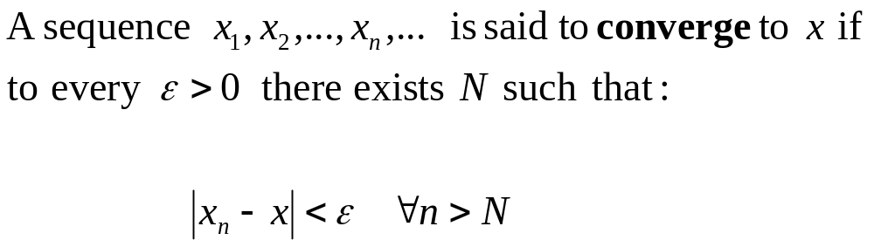
Convergence Notation
Notes:
02/01/23

Slide 38
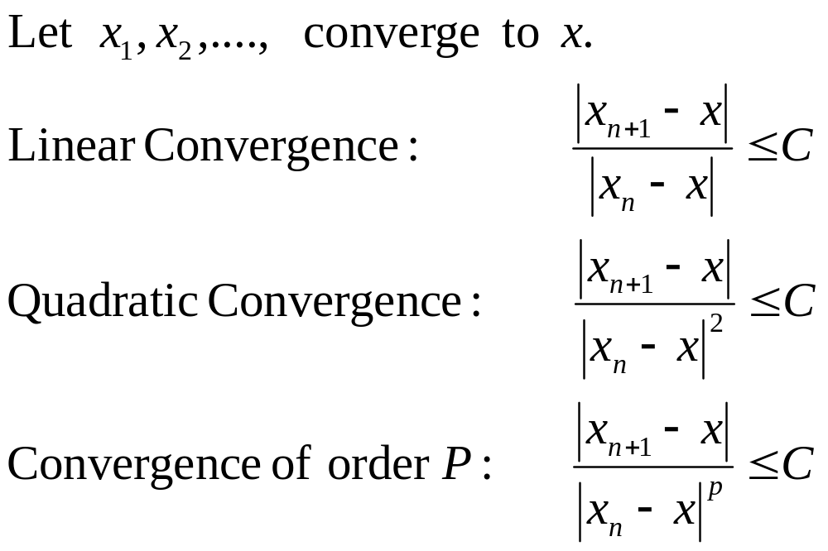
Convergence Notation
Notes:
02/01/23

Slide 39
Speed of Convergence
We can compare different methods in terms of their convergence rate.
Quadratic convergence is faster than linear convergence.
A method with convergence order q converges faster than a method with convergence order p if q>p.
Methods of convergence order p>1 are said to have super linear convergence.
Notes:
02/01/23

Slide 40
Bisection Method
The Bisection method is one of the simplest methods to find a zero of a nonlinear function.
It is also called interval halving method.
To use the Bisection method, one needs an initial interval that is known to contain a zero of the function.
The method systematically reduces the interval. It does this by dividing the interval into two equal parts, performs a simple test and based on the result of the test, half of the interval is thrown away.
The procedure is repeated until the desired interval size is obtained.
Notes:
02/01/23
Convert to Speech:
The Bisection method is one of the simplest methods to find a zero of a nonlinear function.
The method is also called interval halving.
To use the Bisection method, you need an initial interval that is known to contain a zero of the given nonlinear function..
The method systematically reduces the interval.
Bi means two and bisection means divide into two. This is basically what the procedure is doing. It divides the interval into two equal parts, performs a simple test and based on the result of the test half of the interval is thrown away.
The remaining half is divided into two and the test is applied again and the procedure is repeated until the desired interval size is obtained.

Slide 41
Intermediate Value Theorem
Let f(x) be defined on the interval [a,b].
Intermediate value theorem:
if a function is continuous and f(a) and f(b) have different signs then the function has at least one zero in the interval [a,b].
f(a)
a
b
f(b)
Notes:
02/01/23

Slide 42
Examples
If f(a) and f(b) have the same sign, the function may have an even number of real zeros or no real zeros in the interval [a, b].
Bisection method can not be used in these cases.
a
b
The function has four real zeros
a
b
The function has no real zeros
Notes:
02/01/23

Slide 43
Two More Examples
If f(a) and f(b) have different signs, the function has at least one real zero.
Bisection method can be used to find one of the zeros.
a
b
The function has one real zero
a
b
The function has three real zeros
Notes:
02/01/23
Convert to Speech:
if the function is continuous and ef of ay and ef of be have different signs then the functions has at least one zero and the Bisection method can be applied to find a zero of the function.

Slide 44
Bisection Method
If the function is continuous on [a,b] and f(a) and f(b) have different signs, Bisection method obtains a new interval that is half of the current interval and the sign of the function at the end points of the interval are different.
This allows us to repeat the Bisection procedure to further reduce the size of the interval.
Notes:
02/01/23
Convert to Speech:
If the function is continuous on [a,b] and f(a) and f(b) have different signs, Bisection Method obtain a new interval that is half of the current interval and the sign of the function at the end points of the interval are different.
This allows us to repeat the Bisection procedure to further reduce the size of the interval.

Slide 45
Bisection Method
Assumptions:
Given an interval [a,b]
f(x) is continuous on [a,b]
f(a) and f(b) have opposite signs.
These assumptions ensure the existence of at least one zero in the interval [a,b] and the bisection method can be used to obtain a smaller interval that contains the zero.
Notes:
02/01/23
Convert to Speech:
The assumptions are:
Given an interval ae be
The function is continuous on the interal
And the values of ef of a and ef of be have different signs.
These assumptions ensures the existence of at least one zero in the interval [a,b] and the bisection method can be used to obtain a smaller interval that contains the zero.

Slide 46
Bisection Algorithm
Assumptions:
f(x) is continuous on [a,b]
f(a) f(b) < 0
Algorithm:
Loop
1. Compute the mid point c=(a+b)/2
2. Find xc = (a+b)/2.
3. If f(xc) = 0, then xc is the root of the equation.
3. Otherwise, If f(a) f(c) < 0 then new interval [a, c]
If f(a) f(c) > 0 then new interval [c, b]
End loop
We continue this process until we find the root (i.e., f(x_{c})= 0), or the latest interval is smaller than some specified tolerance.
f(a)
c
b
a
f(b)
Notes:
02/01/23
Convert to Speech:
Assuming that the function is continuous on ay be and ef of ay times ef of be is negative. The Bisection algorithm is an iterative procedure that obtains a new interval that is guaranteed to contain a zero of the function.
In each iteration, the first step is to obtain the middle point in the interval then evaluate the function at the mid point. In the third step the new interval is obtained based on the sign of ef of ay times ef of see. If this product is negative then the new interval is ay see otherwise the new interval is ay be.
And the procedure is repeated

Slide 47
Bisection Method
b0
a0
a1
a₂
Notes:
02/01/23

Slide 48
Example
+ + -
+ - -
+ + -
Notes:
02/01/23

Slide 49
Flow Chart of Bisection Method
Start: Given a,b and ε
u = f(a) ; v = f(b)
c = (a+b) /2 ; w = f(c)
no
yes
is
u w <0
no
is
(b-a) /2<ε
Stop
yes
b=c; v= w
a=c; u= w
Notes:
02/01/23
Convert to Speech:
A detailed flow chart of the Bisection algorithm is shown. The program starts with ay , be and epsilon.
Ae and be, the end points of the interval and epsilon is the accuracy level.
The function is evaluated at the end points and the values are stored in u and v.
In each iteration, the middle point c is computed and the function is evaluated and its value is stored in w.
If W times u is negative, That is ef of a times ef of c is negative then the new interval is ay see .
Otherwise the new interval is be see
A stopping criterion is used here. If the size of the interval is less than a desired accuracy level the algorithm is stopped, otherwise the procedure is repeated.

Slide 50
Bisection Method: Example 1
Find the root of the equation x³ + 4x² – 1 = 0.
Solution
Let, a = 0 and b = 1.
Now, f(0) = (0)³ + 4(0)² – 1 = -1 <0 and
f(1) = (1)³ + 4(1)² – 1 = 4 >0.
i.e., f(a) and f(b) has opposite signs.
Therefore, f(x) has a root in the interval [a, b] = [0, 1]
x_{c} = (0 + 1) /2 = 0.5,
f(0.5) = 0.125. Now f(a) and f(x_{c}) has opposite signs
So, the next interval is [0, 0.5]

Slide 51
Bisection Method: Example 1
Find the root of the equation x³ + 4x² – 1 = 0.
Solution
a | b | x_{c} = (a+b)/2 | f(a) | f(b) | f(x_{c})
0 | 1 | 0.5 | -1 | 4 | 0.125
0 | 0.5 | 0.25 | -1 | 0.125 | - 0.73438
0.25 | 0.5 | 0.375 | -0.73438 | 0.125 | - 0.38477
0.375 | 0.5 | 0.4375 | -0.38477 | 0.125 | - 0.15063
0.4375 | 0.5 | 0.46875 | -0.15063 | 0.125 | - 0.0181
0.46875 | 0.5 | 0.484375 | -0.0181 | 0.125 | 0.05212
0.46875 | 0.484375 | 0.476563 | - 0.0181 | 0.05212 | 0.01668
... and so we approach the root 0.472834.

Slide 52
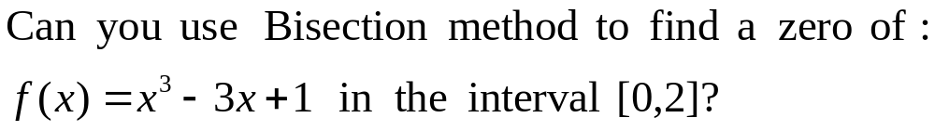
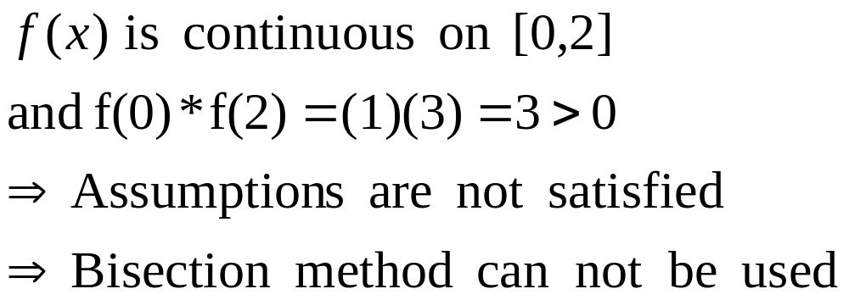
Example
Answer:
Notes:
02/01/23
Convert to Speech:
Can you use bisection method to find a zero of the function
Ex cube minus three x plus one over the interval zero to two.
Answer:
Ef of ex is a polynomial therefore it is continuous. Ef of zero times ef of 2 is equal to three which is positive.
The assumptions are violated and there fore we can not use the bisection method.

Slide 53
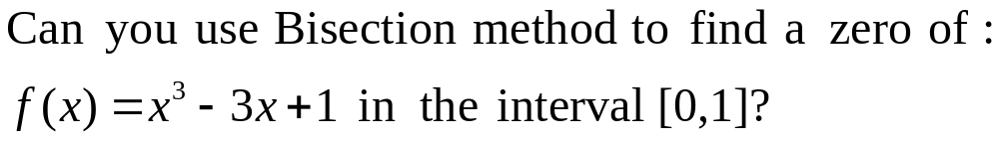
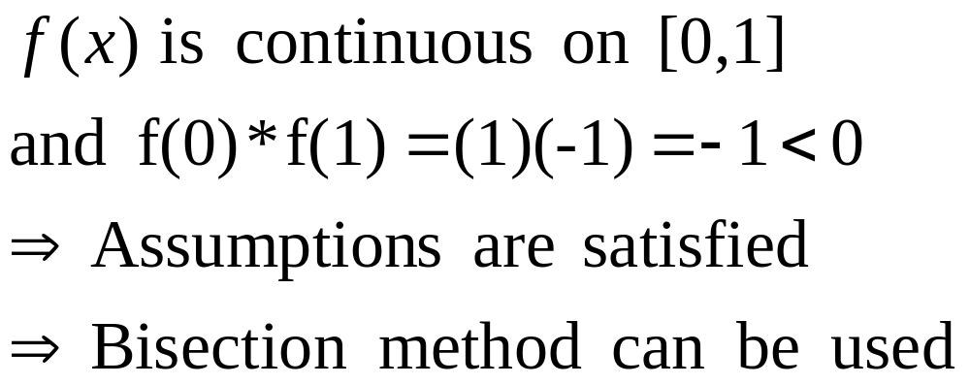
Example
Answer:
Notes:
02/01/23
Convert to Speech:
Can you use bisection method to find a zero of the function
Ex cube minus three x plus one over the interval zero to one.
Answer:
Ef of ex is a polynomial therefore it is continuous. Ef of zero times ef of 1 is equal to minus one.
All assumptions are satisfied and there fore we can use the bisection method.

Slide 54
Best Estimate and Error Level
Bisection method obtains an interval that is guaranteed to contain a zero of the function.
Questions:
What is the best estimate of the zero of f(x)?
What is the error level in the obtained estimate?
Notes:
02/01/23
Convert to Speech:
Best Estimate and error level.
The Bisection method obtains an interval that is grunted to contain a zero of the function. If we want to obtain a single point as the best estimate of the zero of the function, what is that value? and what is the level of the error when this estimate is used?

Slide 55
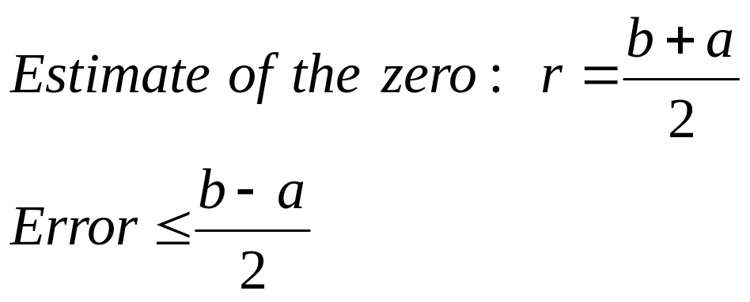
Best Estimate and Error Level
The best estimate of the zero of the function f(x) after the first iteration of the Bisection method is the mid point of the initial interval:
Notes:
02/01/23
Convert to Speech:
Different approaches in selecting the solution can be used. The approach that will be used here is the middle point of the final interval. Doing this we guarantee that the error in estimating the zero of ef of ex is less than or equal to the half of the size of the final interval.

Slide 56
Stopping Criteria
Two common stopping criteria
Stop after a fixed number of iterations
Stop when the absolute error is less than a specified value
How are these criteria related?
Notes:
02/01/23
Convert to Speech:
Two commonly used way to stop the Bisection method.
Stop after a given fixed number of iterations
Or
Stop when the error is less than a specified value.
In fact if one is given the initial interval and the error level, the number of iterations needed to achieve this accuracy can be calculated easily. Similarly if the initial interval and the number of iterations are given then one can obtain an upper bound on the resulted error.

Slide 57
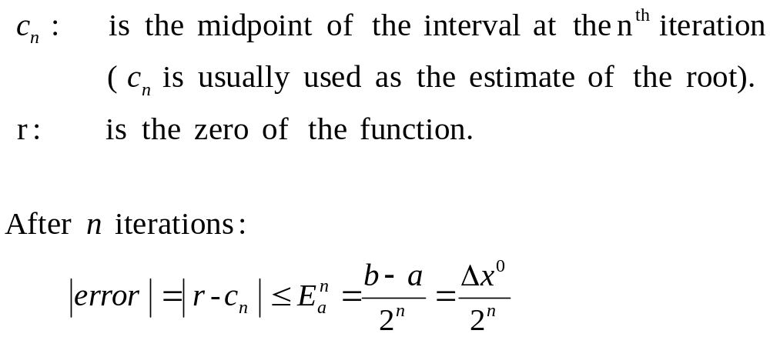
Stopping Criteria
Notes:
02/01/23
The above criteria are related. Fixing the number of iteration, you can get a formula relating the error to the number of iterations.
Let c en be the midpoint of the interval after n iterations and let r be the zero of the function
The error after n iterations is less than b minus a over two to the power n.

Slide 58
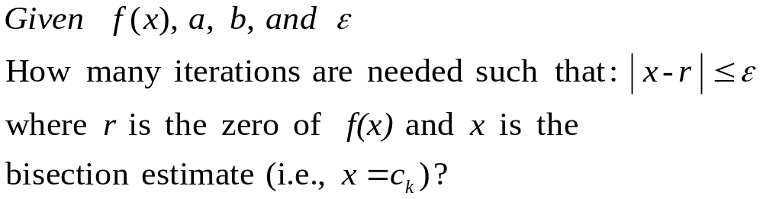
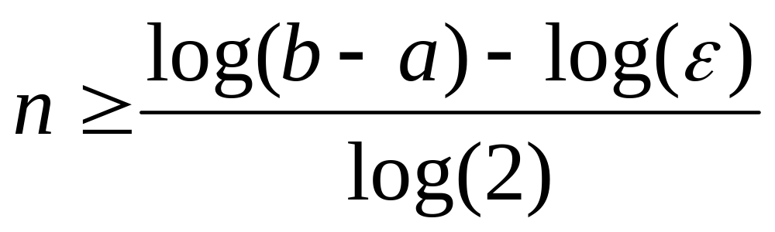
Convergence Analysis
Notes:
02/01/23
Given ef of x , a, b and epsilon
We need to determine the number of iterations such that the absolute of r minus x is less than epsilon.
R here is the zero of the function and x is the bisection estimate. That is x equals see kay
The number of iterations n is given by the equation
N is greater than or equal to log of b minus a minus log of epsilon all over log of two.

Slide 59
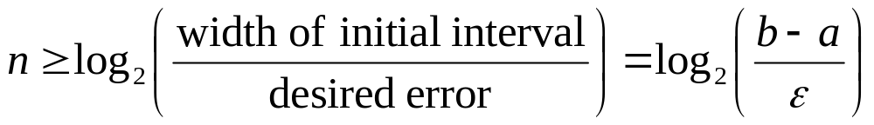
Convergence Analysis – Alternative Form
Notes:
02/01/23
An alternative formula is given here
The number of iterations is greater than or equal to log to base two of the ratio of the width of the initial interval to the desired error.

Slide 60
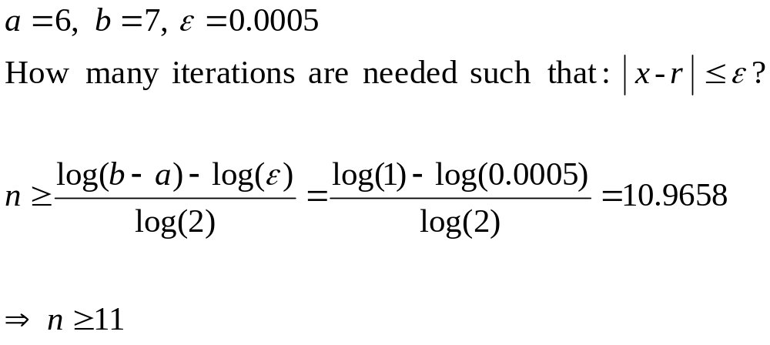
Example
Notes:
02/01/23
In this example the formula for the number of iterations is used to answer the question
How many iterations of the bisection method is needed so that the error is less than epsilon
Here ay is 6, bee is 7 and epsilon is 0.0005
Direct substitution results in the inequality n must be greater than or equal to eleven.

Slide 61
Example
Use Bisection method to find a root of the equation x = cos (x) with absolute error <0.02
(assume the initial interval [0.5, 0.9])
Question 1: What is f (x) ?
Question 2: Are the assumptions satisfied ?
Question 3: How many iterations are needed ?
Question 4: How to compute the new estimate ?
Notes:
02/01/23
to solve this problem we need to answer four questions
What is f (x) in case it is not available directly.
Are the assumptions satisfied ?
How many iterations are needed to achieve the desired accuracy?
And finally
How to compute the new estimate ?

Slide 62
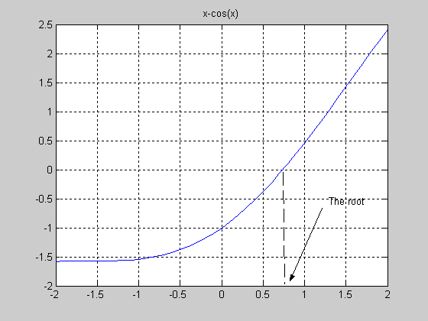
CISE301_Topic2
Notes:
02/01/23
This graph shows a plot of the function x minus cosine ex
The zero of the function is approximatley zero point seven and the interval zero pont five to zero point nine contains the zero for sure.

Slide 63
Bisection Method
Initial Interval
f(a)=-0.3776 f(b) =0.2784
Error < 0.2
a =0.5 c= 0.7 b= 0.9
Notes:
02/01/23

Slide 64
Bisection Method
-0.3776 -0.0648 0.2784
Error < 0.1
0.5 0.7 0.9
-0.0648 0.1033 0.2784
Error < 0.05
0.7 0.8 0.9
Notes:
02/01/23

Slide 65
Bisection Method
-0.0648 0.0183 0.1033
Error < 0.025
0.7 0.75 0.8
-0.0648 -0.0235 0.0183
Error < .0125
0.70 0.725 0.75
Notes:
02/01/23

Slide 66
Summary
Initial interval containing the root: [0.5,0.9]
After 5 iterations:
  Interval containing the root: [0.725, 0.75]
  Best estimate of the root is 0.7375
  | Error | < 0.0125
Notes:
02/01/23

Slide 67
A Matlab Program of Bisection Method
a=.5; b=.9;
u=a-cos(a);
v=b-cos(b);
for i=1:5
c=(a+b)/2
fc=c-cos(c)
if u*fc<0
b=c ; v=fc;
else
a=c; u=fc;
end
end
c =
0.7000
fc =
-0.0648
c =
0.8000
fc =
0.1033
c =
0.7500
fc =
0.0183
c =
0.7250
fc =
-0.0235
Notes:
02/01/23
This a simple MATLAB implementation of the Bisection algorithm
The first line defines the end points of the interval
In the following two lines the value of the function at the end points are evaluated
The fourth line is the start of the loop and five iterations of bisection method will be used.
In each iteration , the middle point is calculated and the value of the function at the middle point is evaluated.
Followed by a test to determine the new interval.
The procedure is repeated five times

Slide 68
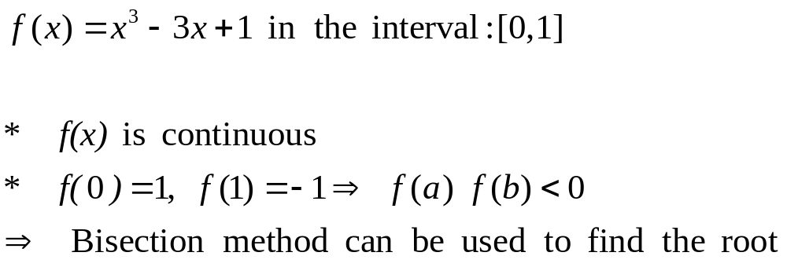
Example
Find the root of:
Notes:
02/01/23

Slide 69
Example
Iteration | a | b | c= (a+b) 2 | f(c) | (b-a) 2
1 | 0 | 1 | 0.5 | -0.375 | 0.5
2 | 0 | 0.5 | 0.25 | 0.266 | 0.25
3 | 0.25 | 0.5 | .375 | -7.23E-3 | 0.125
4 | 0.25 | 0.375 | 0.3125 | 9.30E-2 | 0.0625
5 | 0.3125 | 0.375 | 0.34375 | 9.37E-3 | 0.03125
Notes:
02/01/23

Slide 70
Bisection Method
Advantages
Simple and easy to implement
One function evaluation per iteration
The size of the interval containing the zero is reduced by 50% after each iteration
The number of iterations can be determined a priori
No knowledge of the derivative is needed
The function does not have to be differentiable
Disadvantage
Slow to converge
Good intermediate approximations may be discarded
We need two initial guesses a and b which bracket the root.
It is among the slowest methods to find the root.
When an interval contains more than one root, the bisection method can find only one of them.
Notes:
02/01/23

Slide 71
Bisection Method: Class Work
Find the real root of the equation f(x)=x3 – x – 1= 0 correct to 2 decimal places.(ε=0.01).
Answer: 1.328125
Find the real root of the equation f(x)=x4 - cos(x) + x = 0 correct to 2 decimal places.(ε=0.01).
Answer: 0.637695

Slide 72
Iteration Method
Suppose we have an equation in the form g(x) = 0
Rewrite the equation in the form x = f(x).
Start with an initial guess x₀, which is an approximation of the root.
Calculate x₁, ..., x_{n},... such that
  x₁ = f(x₀)
  x₂= f(x₁)
  x₃= f(x₂) ...
Iterate the same process until (x_{n} – x_{n-1}) smaller than some specified tolerance.
Geometrically, where the two graphs x and f(x) intersects, that is the real root of the equation.

Slide 73
Iteration Method: Convergence Conditions
Any arbitrary approximation x₀, x₁, x₂ does not assure that it will converge to the actual root x of the equation.
  E.g. x = 10^{x} + 1,
  if x₀ = 0, x₁ = 2, x₂ = 101, …. that does not converge to the actual root x
  As n increase, x_{n} increases without limit!
The equation x = f(x) converges to the real root x,
  if f(x) is continuous
  If | f ′(x) | < 1
The equation x = f(x) does not converges to the real root x if | f ′(x) | > 1
Therefore, g(x) = 0 has to be re-written as x = f(x) in such a way that | f ′(x) | < 1

Slide 74
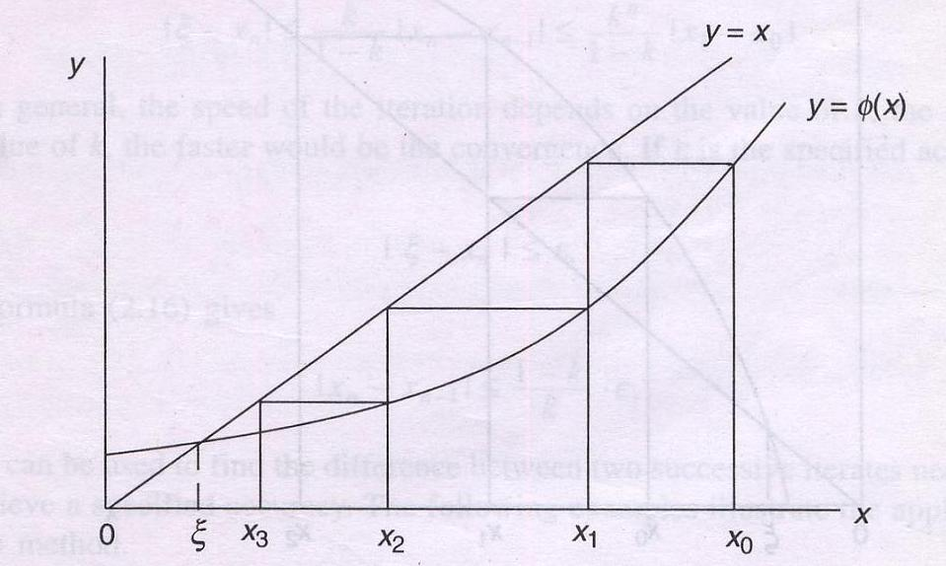
Iteration Method: Convergence Conditions
Convergence of x_{n+1} = f(x_{n}), when | f ′ (x) | < 1
The root of this equation

Slide 75
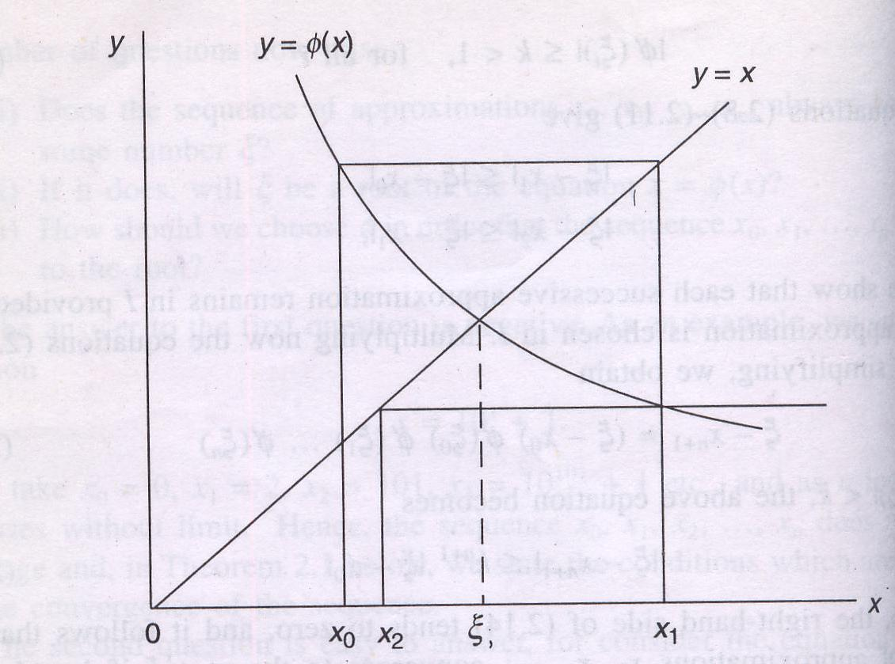
Iteration Method: Convergence Conditions
x_{n+1} = f(x_{n}) oscillates but ultimately converges, when | f ′ (x) | < 1, but f ′ (x) < 0
The root of this equation

Slide 76
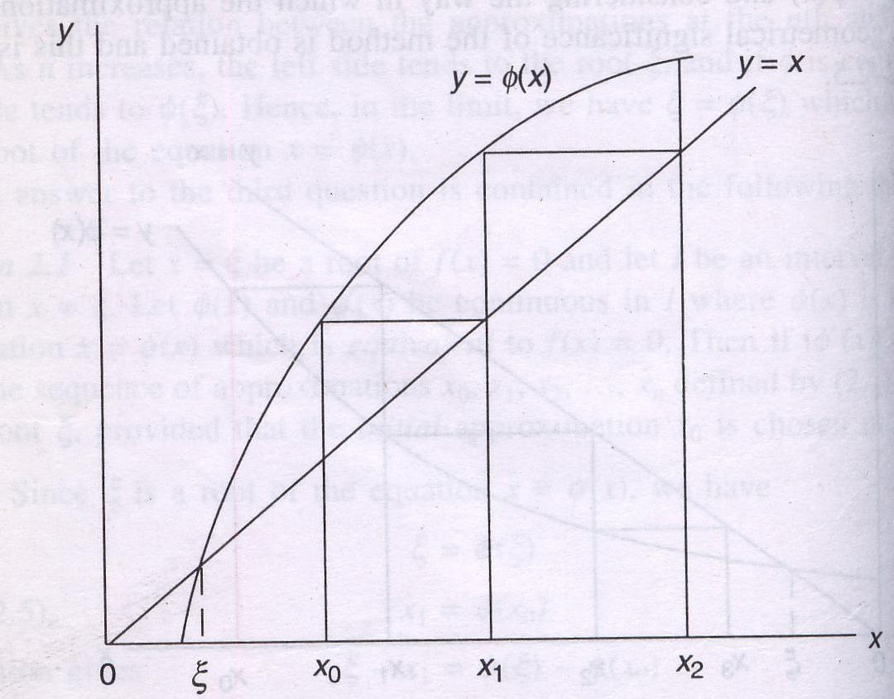
Iteration Method: Convergence Conditions
x_{n+1} = f(x_{n}) diverges, when f ′ (x) > 1
The root of this equation

Slide 77
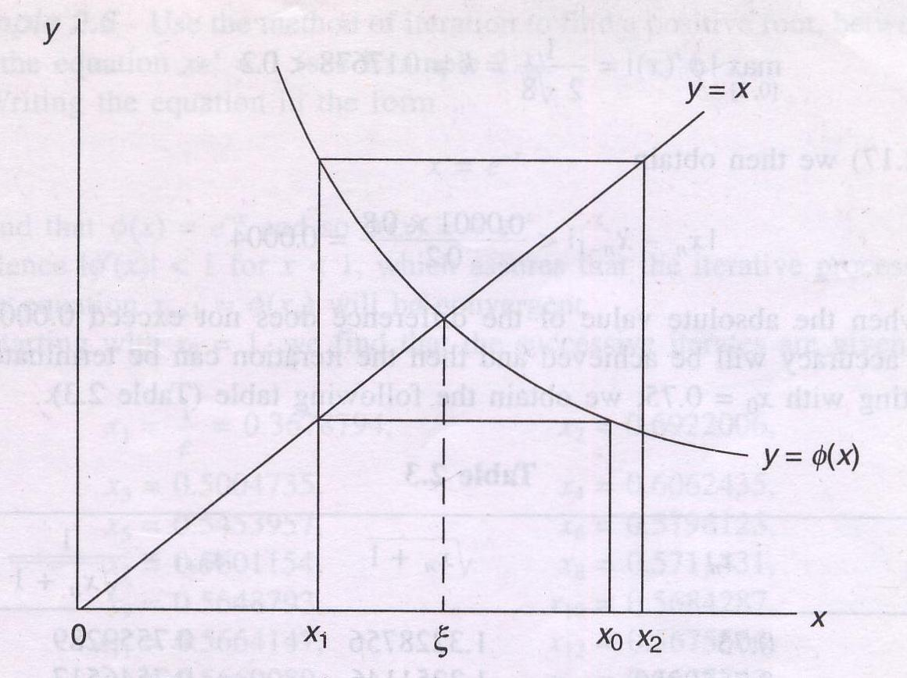
Iteration Method: Convergence Conditions
x_{n+1} = f(x_{n}) diverges, when f ′ (x) > 1
The root of this equation

Slide 78
Iteration Method: Example
Solve x = 2 + sin(x)/2
Solution
Here f(x) = 2 + sin(x)/2
Starting with x₀ = 2 we calculate x₁, x₂,...
x₀ | 2
x₁ = f(x₀) | 2.454648713
x₂ = f(x₁) | 2.31708862
x₃ = f(x₂) | 2.367105575
x₄ = f(x₃) | 2.349674771
x₅ = f(x₄) | 2.355850929
x₆ = f(x₅) | 2.353674837
x₇ = f(x₆) | 2.354443099
x₈ = f(x₇) | 2.354172058
x₉ = f(x₈) | 2.354267705
x₁₀ = f(x₉) | 2.354233955
x₁₁ = f(x₁₀) | 2.354245864

Slide 79
Iteration Method: Example
Find the real root of the equation
g(x)= x³ + x² - 1=0
Rewrite g(x)
x³ + x² - 1=0
or, x³ + x² = 1
or, x²(x+1) = 1
or, x² = 1/(x+1)
or, x = 1/√(x+1)
Let, x₀ = 0.75
x₀ = 0.7500000
x₁ = 0.7559289
x₂ = 0.7546517
x₃ = 0.7549263
x₄ = 0.7548672
x₅ = 0.7548799
x₆ = 0.7548772
x₇ = 0.7548778
x₈ = 0.7548776
x₉ = 0.7548777
x₁₀ = 0.7548777

Slide 80
Iteration Method: Class Work
Find the real root of the equation using iterative method (till 4 decimal places).
e^{-x} = 10x
Answer: 0.091276527

Slide 81
Iterative Method: Drawbacks
We need an approximate initial guesses x₀.
It is also a slower method to find the root.
If the equation has more than one roots, then this method can find only one of them.

Slide 82
Newton-Raphson Method
This method is more efficient than the Bisection and Iteration methods.
If
x is the real root and x₀ is an initial approximation of the real root of an equation f(x) = 0,
f ´(x₀) ≠ 0,
f(x) has the same sign between x₀ and x,
Then, the tangent at f(x₀) can lead to the real root x.

Slide 83
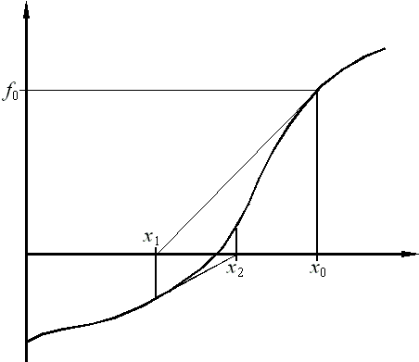
Newton-Raphson Method: Geometric Significance
f(x₀)
tangent at f(x₀)
The initial guess
f(x₁)

Slide 84
Newton-Raphson Method: Geometric Significance
Here,
The slope at x₁ is tan (PTM)
tan (PTM) = PM/TM
tan (PTM) = f (x₀)/h
Again, tan (PTM) = f ´(x₀)
Therefore, f ´(x₀) = f (x₀)/h
Or, h = f (x₀)/ f ´(x₀)
x₁ = x₀ – h
Therefore, x₁ = x₀ – f (x₀)/ f ´(x₀)
Similarly, x₂ = x₁ – f (x₁)/ f ´(x₁)
P
T
M

Slide 85
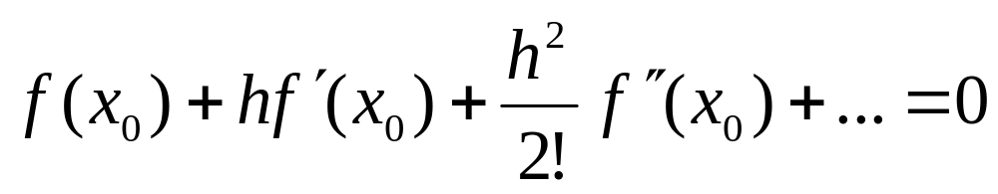
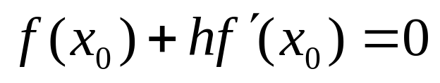
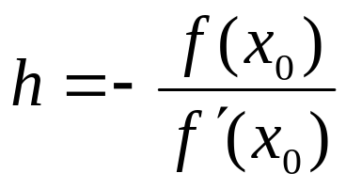
Newton-Raphson Method
Methodology
  Let x₀ be an approximate root of f(x) = 0 and
  Let, x₁ is the correct root such that x₁ = x₀ + h and f(x₁) = 0.
  Expanding f(x₀+h) by Taylor’s series, we obtain,
  Neglecting the second and higher order derivatives, we have
  Which gives

Slide 86
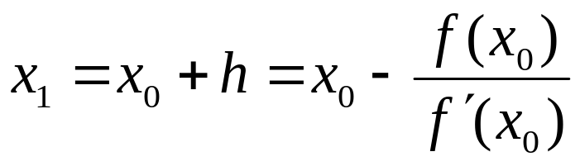
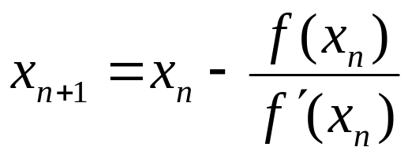
Newton-Raphson Method (Cont’d.)
A better approximation than x₀ is therefore given by x₁ where
Successive approximation are given by x₂, x₃, ….., x_{n}, x_{n+1} where
This formula is known as the Newton-Raphson formula.

Slide 87
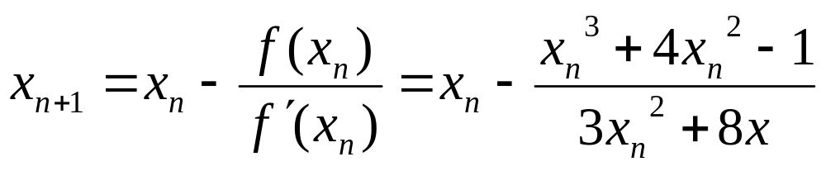
Newton-Raphson Method: Example
Find the real root of the equation using Newton-Raphson’s Method
f(x)= x³ + 4x² – 1= 0, f′(x) = 3x² + 4*2x - 0
x₀ | 0.5
x₁ | 0.473684211
x₂ | 0.472834787
x₃ | 0.472833909
x₄ | 0.472833909

Slide 88
Newton-Raphson Method: Example
Class work
Use Newton-Raphson’s Method to find a root of the equation correct to 2 decimal places.(ε=0.01)
x³ – 2x – 5 = 0
f(x) = x³ – 2x -5
f ′(x) = 3x² – 2
Result 2.094551482

Slide 89
Newton-Raphson Method: Example
Class work
Use Newton-Raphson’s Method to find a root of the equation correct to 2 decimal places.(ε=0.01)
x sin x = - cos x
f(x) = x sin x + cos x
f ′(x) = x cos x
Result 2.798386046

Slide 90
Advantages
Converges fast (quadratic convergence), if it converges.
Requires only one guess

Slide 91
Newton-Raphson Method: Drawbacks
The Newton-Raphson method requires the calculation of the derivative of a function, which is not always easy.
If f' vanishes at an iteration point, then the method will fail to converge.
When the step is too large or the value is oscillating, other more conservative methods should take over the case.

Slide 92
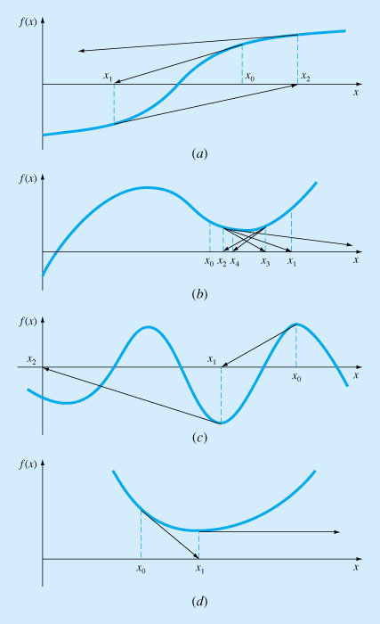
Pitfalls of The Newton Raphson Method
Cases where Newton Raphson method diverges or exhibit poor
convergence.
a) Reflection point b) oscillating around a local optimum
c) Near zero slop , and d) zero slop

Slide 93
The Method of False Position Or Regula Falsi
Like the bisection method, Method of False Position requires two initial guesses x_{a} and x_{b} such that f(x) = 0 and f(x_{a}) and f(x_{b}) has opposite signs.
Since the graph of y = f(x) crosses the x-axis between these two points, a root must lie in between these points.
The difference between these two methods is, instead of simply dividing the region in two, it obtains a new point x₁ which is (hopefully, but not necessarily) closer to the root.
If f(x_{a}) and f(x₁) has opposite signs, then the new interval to be explored is [x_{a}, x₁].
Otherwise, the new interval is [x_{b}, x₁].
The procedure is repeated till the root is obtained to the desired accuracy.

Slide 94
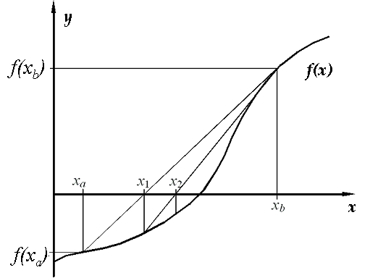
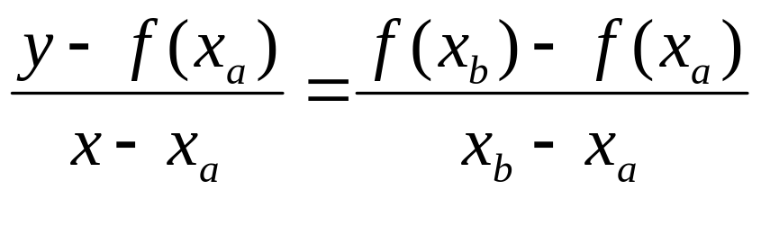
The Method of False Position
This method consists in replacing the part of the curve between the points (x_{a}, f(x_{a})) and (x_{b}, f(x_{b})).
The equation of the chord joining the two points (x_{a} , f(x_{a})) and (x_{b} , f(x_{b})) is
It takes the point of intersection of the chord with the x-axis as an approximation to the root (here, x₁).
(x_{b}, f(x_{b}))
(x₁, f(x₁))
(x_{a}, f(x_{a}))

Slide 95
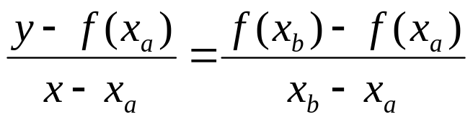
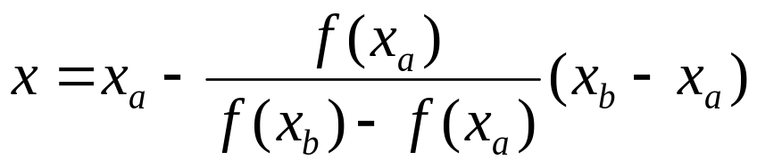
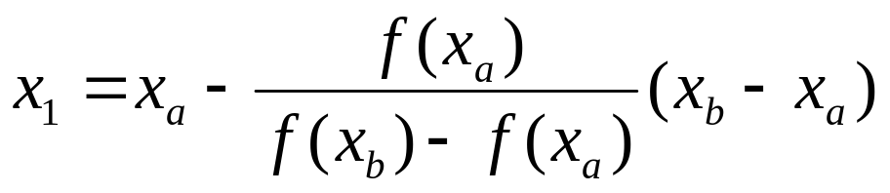
The Method of False Position
The point of intersection in the present case is given by putting y = 0 in the equation
Thus we obtain
Hence, the approximate root is

Slide 96
The Method of False Position : Geometric Significance
Here, for Δ PMS and Δ PRQ
MS/MP = RQ/RP
(x₁–x_{a})/f(x_{a}) = (x_{b} – x_{a}) /(f(x_{b})+- f(x_{a}))
x₁–x_{a} = f(x_{a})(x_{b}– x_{a}) /(f(x_{a})+- f(x_{b}))
x₁ = x_{a} - f(x_{a})(x_{b}– x_{a}) /(f(x_{b}) - f(x_{a}))
P
M
S
x_{a}
x₁
x_{b}
f(x)
R
Q

Slide 97
The Method of False Position: Example
Find the real root of the equation till 2 decimal place
f(x)= x³ - 2x – 5 = 0
We observe that f(2) = -1 and f(3) = 16
And hence a root lies between 2 and 3. Then
x₄ is correct to 2 decimal places.
x0 | x1 | x2 | f(x0) | f(x1) | f(x2)
2 | 3 | 2.058824 | -1 | 16 | -0.3908
2.058824 | 3 | 2.081264 | -0.3908 | 16 | -0.1472
2.081264 | 3 | 2.089639 | -0.1472 | 16 | -0.05468
2.089639 | 3 | 2.09274 | -0.05468 | 16 | -0.0202
2.09274 | 3 | 2.093884 | -0.0202 | 16 | -0.00745
x1 | 2.059
x2 | 2.081
x3 | 2.090
x4 | 2.093

Slide 98
The Method of False Position: Example
Class Work
Find the real root of the equation till 2 decimal place
x³ - 2x² + 3x = 5 between the points 1 and 2.
Result 1.843734

Slide 99
The Method of False Position: Example
Class Work
Find the real root of the equation till 2 decimal place
sin x + x – 1 = 0.
Result 0.510973

Slide 100
Pitfalls of the False Position Method
Although a method such as false position is often superior to bisection, there are some cases (when function has significant curvature) that violate this general conclusion.
In such cases, the approximate error might be misleading and the results should always be checked by substituting the root estimate into the original equation and determining whether the result is close to zero.
major weakness of the false-position method: its one sidedness That is, as iterations are proceeding, one of the bracketing points will tend stay fixed which lead to poor convergence.

Slide 101
Advantages:
  1. Simple
2. Brackets the Root
Disadvantages:
  1. Can be VERY slow
  2. Like Bisection, need an initial interval around the root.

Slide 102
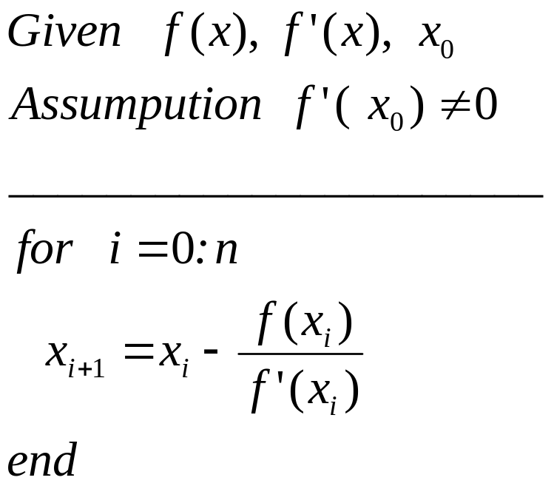
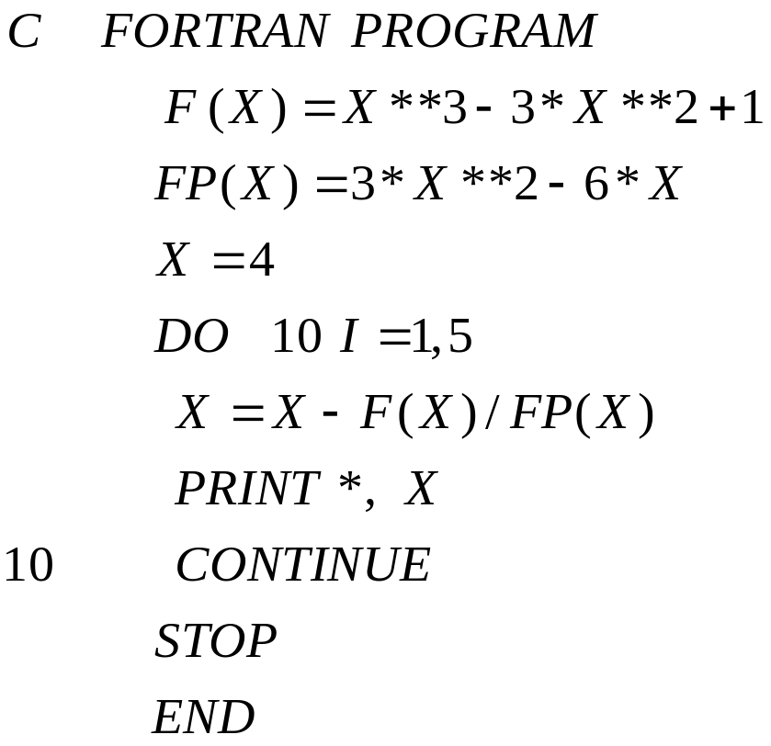
Newton’s Method
Notes:
02/01/23

Slide 103

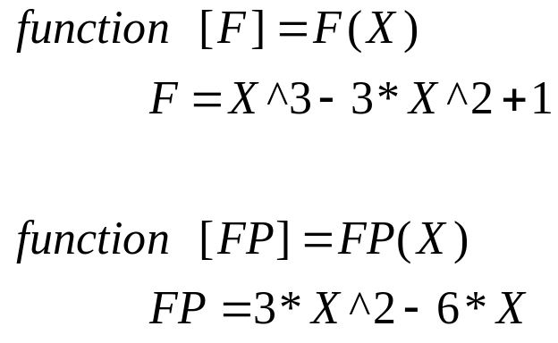

Newton’s Method
F.m
FP.m
Notes:
02/01/23

Slide 104

Example
Notes:
02/01/23

Slide 105
Example
k (Iteration) | x_{k} | f(x_{k}) | f’(x_{k}) | x_{k+1} | |x_{k+1} –x_{k}|
0 | 4 | 33 | 33 | 3 | 1
1 | 3 | 9 | 16 | 2.4375 | 0.5625
2 | 2.4375 | 2.0369 | 9.0742 | 2.2130 | 0.2245
3 | 2.2130 | 0.2564 | 6.8404 | 2.1756 | 0.0384
4 | 2.1756 | 0.0065 | 6.4969 | 2.1746 | 0.0010
CISE301_Topic2
Notes:
02/01/23

Slide 106

Convergence Analysis
CISE301_Topic2
Notes:
02/01/23

Slide 107
Convergence Analysis
Remarks
When the guess is close enough to a simple root of the function then Newton’s method is guaranteed to converge quadratically.
Quadratic convergence means that the number of correct digits is nearly doubled at each iteration.
CISE301_Topic2
Notes:
02/01/23

Slide 108
Problems with Newton’s Method
If the initial guess of the root is far from
the root the method may not converge.
Newton’s method converges linearly near
multiple zeros { f(r) = f’(r) =0 }. In such a
case, modified algorithms can be used to
regain the quadratic convergence.
CISE301_Topic2
Notes:
02/01/23

Slide 109


Multiple Roots
CISE301_Topic2
Notes:
02/01/23

Slide 110
Problems with Newton’s Method
- Runaway -
x₀
x₁
The estimates of the root is going away from the root.
CISE301_Topic2
Notes:
02/01/23

Slide 111
Problems with Newton’s Method
- Flat Spot -
x₀
The value of f’(x) is zero, the algorithm fails.
If f ’(x) is very small then x₁ will be very far from x₀.
CISE301_Topic2
Notes:
02/01/23

Slide 112
Problems with Newton’s Method
- Cycle -
x₁=x₃=x₅
x₀=x₂=x₄
The algorithm cycles between two values x₀ and x₁
CISE301_Topic2
Notes:
02/01/23

Slide 113

Newton’s Method for Systems of Non Linear Equations
CISE301_Topic2
Notes:
02/01/23

Slide 114


Example
Solve the following system of equations:
CISE301_Topic2
Notes:
02/01/23

Slide 115

Solution Using Newton’s Method
CISE301_Topic2
Notes:
02/01/23

Slide 116


Example
Try this
Solve the following system of equations:
CISE301_Topic2
Notes:
02/01/23

Slide 117

Example
Solution
CISE301_Topic2
Notes:
02/01/23

Slide 118
Lectures 10
Secant Method
Secant Method
Examples
Convergence Analysis
CISE301_Topic2
Notes:
02/01/23

Slide 119

Newton’s Method (Review)
CISE301_Topic2
Notes:
02/01/23

Slide 120

Secant Method
CISE301_Topic2
Notes:
02/01/23

Slide 121

Secant Method
CISE301_Topic2
Notes:
02/01/23

Slide 122

Secant Method
CISE301_Topic2
Notes:
02/01/23

Slide 123



Secant Method - Flowchart
NO
Yes
Stop
CISE301_Topic2
Notes:
02/01/23

Slide 124

Modified Secant Method
CISE301_Topic2
Notes:
02/01/23

Slide 125


Example
CISE301_Topic2
Notes:
02/01/23

Slide 126
Example
x(i) | f(x(i)) | x(i+1) | |x(i+1)-x(i)|
-1.0000 | 1.0000 | -1.1000 | 0.1000
-1.1000 | 0.0585 | -1.1062 | 0. 0062
-1.1062 | 0.0102 | -1.1052 | 0.0009
-1.1052 | 0.0001 | -1.1052 | 0.0000
CISE301_Topic2
Notes:
02/01/23

Slide 127

Convergence Analysis
The rate of convergence of the Secant method is super linear:
It is better than Bisection method but not as good as Newton’s method.
CISE301_Topic2
Notes:
02/01/23

Slide 128
Lectures 11
Comparison of Root
Finding Methods
Advantages/disadvantages
Examples
CISE301_Topic2
Notes:
02/01/23

Slide 129
Summary
Method | Advantages | Disadvantages
Bisection | - Easy, Reliable, Convergent - One function evaluation per iteration - No knowledge of derivative is needed | - Slow - Needs an interval [a,b] containing the root, i.e., f(a)f(b)<0
Newton | - Fast (if near the root) - Two function evaluations per iteration | - May diverge - Needs derivative and an initial guess x0 such that f’(x0) is nonzero
Secant | - Fast (slower than Newton) - One function evaluation per iteration - No knowledge of derivative is needed | - May diverge - Needs two initial points guess x0, x1 such that f(x0)- f(x1) is nonzero
CISE301_Topic2
Notes:
02/01/23

Slide 130

Example
CISE301_Topic2
Notes:
02/01/23

Slide 131
Solution
_______________________________
k x_{k} f(x_{k})
_______________________________
0 1.0000 -1.0000
1 1.5000 8.8906
2 1.0506 -0.7062
3 1.0836 -0.4645
4 1.1472 0.1321
5 1.1331 -0.0165
6 1.1347 -0.0005
CISE301_Topic2
Notes:
02/01/23

Slide 132

Example
CISE301_Topic2
Notes:
02/01/23

Slide 133
Five Iterations of the Solution
k x_{k} f(x_{k}) f’(x_{k}) ERROR
______________________________________
0 1.0000 -1.0000 2.0000
1 1.5000 0.8750 5.7500 0.1522
2 1.3478 0.1007 4.4499 0.0226
3 1.3252 0.0021 4.2685 0.0005
4 1.3247 0.0000 4.2646 0.0000
5 1.3247 0.0000 4.2646 0.0000
CISE301_Topic2
Notes:
02/01/23

Slide 134

Example
CISE301_Topic2
Notes:
02/01/23

Slide 135

Example
CISE301_Topic2
Notes:
02/01/23

Slide 136
Example
Estimates of the root of: x-cos(x)=0.
0.60000000000000 Initial guess
0.74401731944598 1 correct digit
0.73909047688624 4 correct digits
0.73908513322147 10 correct digits
0.73908513321516 14 correct digits
CISE301_Topic2
Notes:
02/01/23

Slide 137
Example
In estimating the root of: x-cos(x)=0, to get more than 13 correct digits:
4 iterations of Newton (x₀=0.8)
43 iterations of Bisection method (initial
interval [0.6, 0.8])
5 iterations of Secant method
( x₀=0.6, x₁=0.8)
CISE301_Topic2
Notes:
02/01/23

